Slide 1

Swimming Pool

Slide 2


Programs/languages we used in the project
C++
Visual Studio 2019 IDE

Slide 3



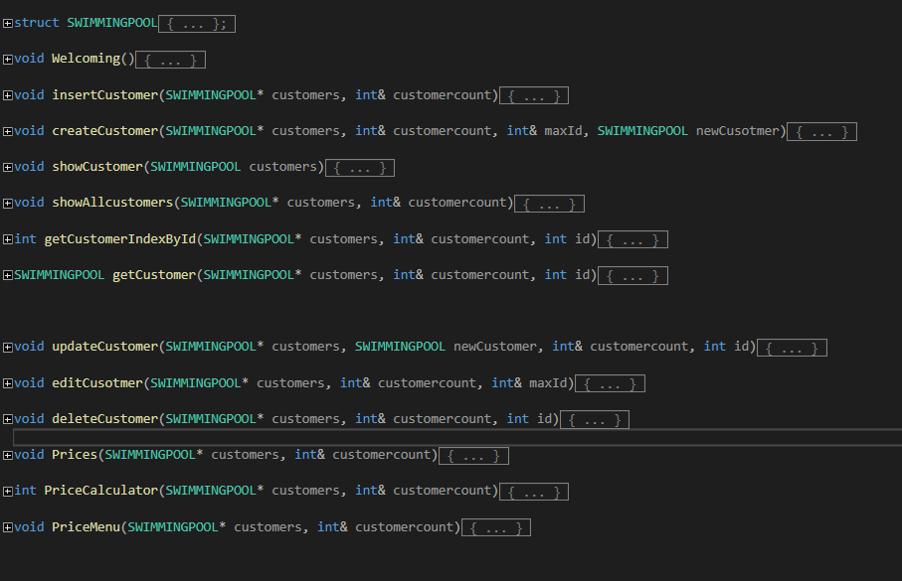
Resume
Our computer program has features for adding, displaying, editing, deleting and showing clients by criteria as well as the income for the day.

Slide 4

Advantages and Disadvantages
It can facilitate and speed up the work of people at the swimming pools, especially the water parks.
it is in a very early state of development

Slide 5
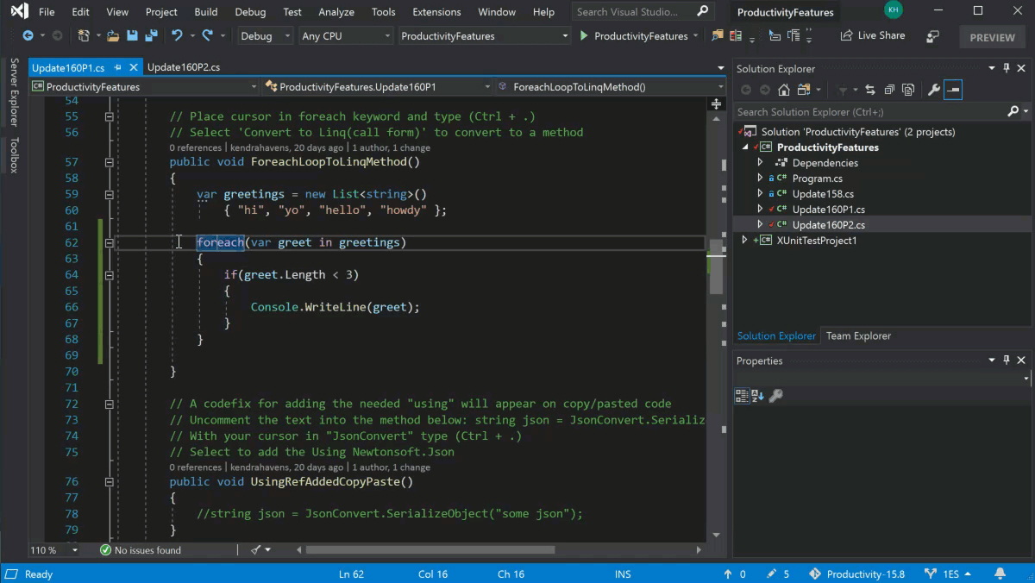
How we did it ?
We used Visual Studio 2019 IDE to develop our computer program

Slide 6



Future plans

Slide 7


